Slide 1
Utility Billing System
A Secure Full-Stack Web Application using ASP.NET Core & Angular
Presented by:
Ashutosh Jena

Slide 2
Table Of Contents
Business Context & Problem Statement
Project Objectives
Technology Stack (Backend & Frontend)
System Architecture
User Roles & Security Implementation
System Workflow (Flowchart)
Core Modules & Features
Data Analytics and LINQ Implementation
UI Screenshots
Live Demonstration

Slide 3
Business Context & Problem Statement
The Current Landscape
Utility providers manage thousands of consumer connections and billing cycles.
Reliance on semi-manual systems leads to critical inefficiencies.
Core Challenges
Accuracy: Incorrect meter readings and frequent billing errors.
Efficiency: Delays in bill generation and payment tracking.
Revenue: Limited visibility into outstanding dues and financial analytics.
Experience: Consumers lack easy access to view bills or make payments.
The Strategic Need
A centralized, automated, and secure system to manage the entire billing lifecycle.

Slide 4
Project Objectives
Primary Goal
To design and develop a centralized, secure Full-Stack Utility Billing Application that automates billing and payments.
Technical Objectives
Backend: Implement a robust RESTful API using ASP.NET Core Web API (.NET 9).
Frontend: Build a responsive, modular UI using Angular and TypeScript.
Security: Enforce JWT-based authentication & Role-Based Access Control (RBAC).
Architecture: Apply Clean Architecture principles and enterprise best practices.
Functional Objectives
Automation: Streamline meter reading entry and auto-generate periodic bills.
Tracking: Provide real-time visibility into payments and outstanding balances.
Insights: Enable data-driven decision-making through dashboards and reports.

Slide 5
Technology Stack
Backend (Server-Side)
Framework: ASP.NET Core Web API (.NET 9)
Database: SQL Server
ORM: Entity Framework Core (Code-First approach)
Authentication: JWT (JSON Web Tokens) Identity
Documentation: Swagger
Frontend (Client-Side)
Framework: Angular (Latest Version)
Language: TypeScript
UI Components: Angular Material
State/Data: Reactive Forms & HTTPClient
Tools & Testing
API Testing: Postman
Unit Testing: xUnit
Version Control: Git / GitHub

Slide 6
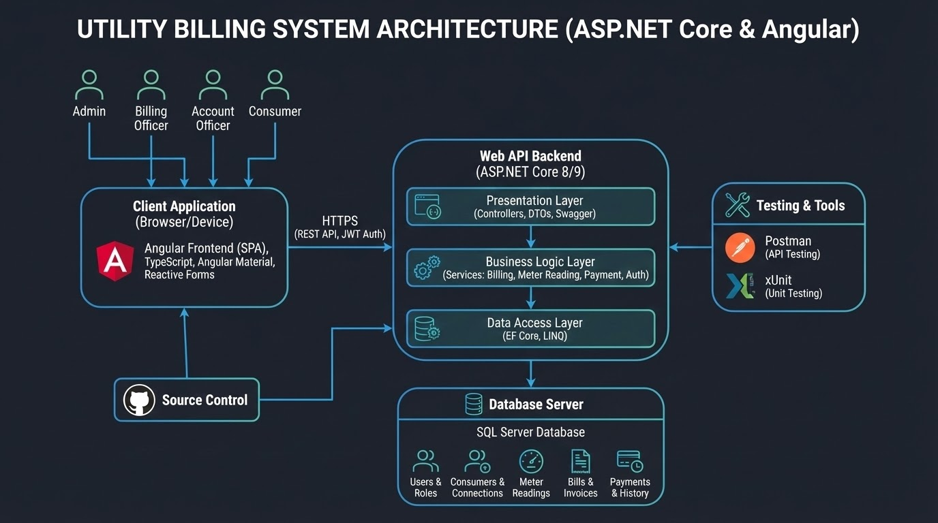

Slide 7
User Roles & Security Implementation
Authentication Strategy
JWT (JSON Web Tokens): Stateless authentication mechanism used for all API requests.
Identity Management: ASP.NET Core Identity used for secure password hashing and user storage.
Role-Based Access Control (RBAC)
Admin: Full access to system configuration (Masters, Tariffs).
Billing Officer: Restricted access to Meter Readings and Bill Generation only.
Account Officer: Restricted access to Payment Recording and Dues Tracking.
Consumer: Read-only access to their own data (Bills, History) + Payment initiation.
Security Best Practices
CORS Policies: Configured to allow requests only from the Angular frontend.
Data Protection: Sensitive data (like passwords) is hashed before storage.
Global Exception Handling: Prevents implementation details from leaking in API error responses.

Slide 8
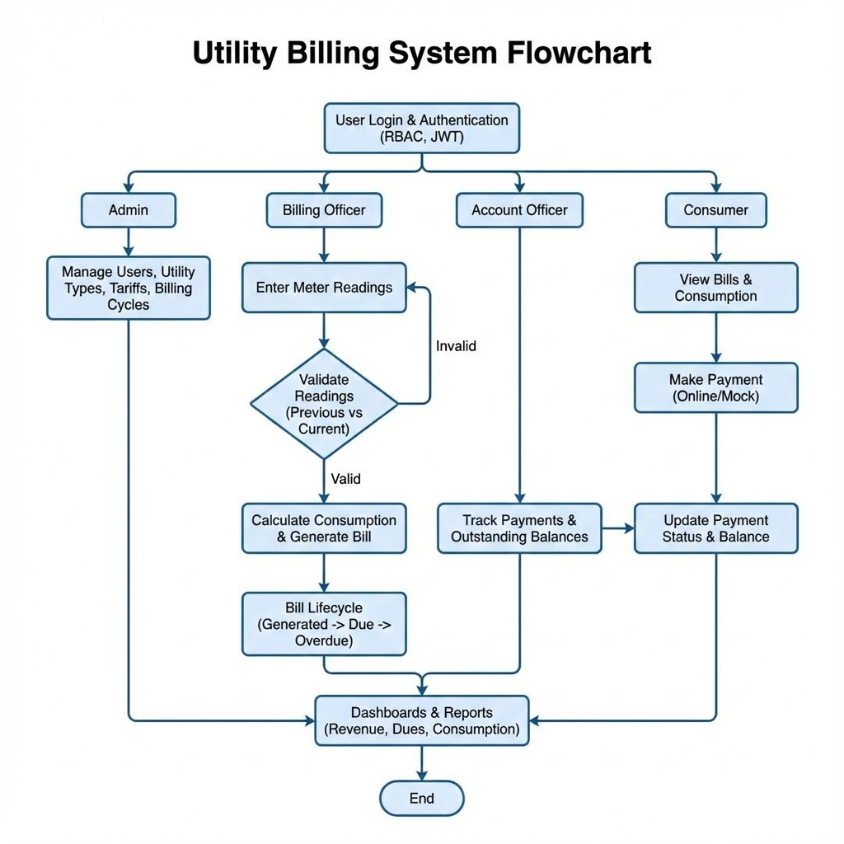

Slide 9
Core Modules & Features
1. Consumer & Connection Management
Onboarding: Secure registration and profile management for new consumers.
Connection Details: Manages meter types, tariff plans, and address details.
2. Meter Reading & Validation
Data Entry: Monthly recording of meter readings by Billing Officers.
Validation Logic: System automatically flags if Current Reading < Previous Reading.
Calculation: Auto-computes consumption units based on the difference.
3. Billing & Invoicing Engine
Auto-Generation: Generates bills applying tariff rates, taxes, and fixed charges.
Lifecycle Management: Tracks bill status automatically: Generated → Due → Paid → Overdue.
4. Payment & Reporting
Payment Tracking: specific module to record cash/online payments and update outstanding balances.
Dashboards: Visual analytics for Total Revenue, Outstanding Dues, and Consumption Trends.

Slide 10
Data Analytics and LINQ Implementation
Advanced Querying: Leveraging LINQ for sophisticated reporting.
Key Metrics Demonstrated:
Total Revenue per month.
Total Outstanding dues.
Average consumption patterns across utility types.
Consumer-wise billing summaries.

Slide 11
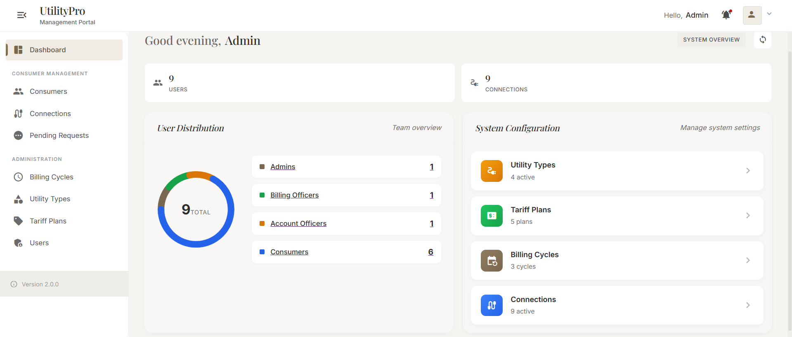
UI Screenshots

Slide 12
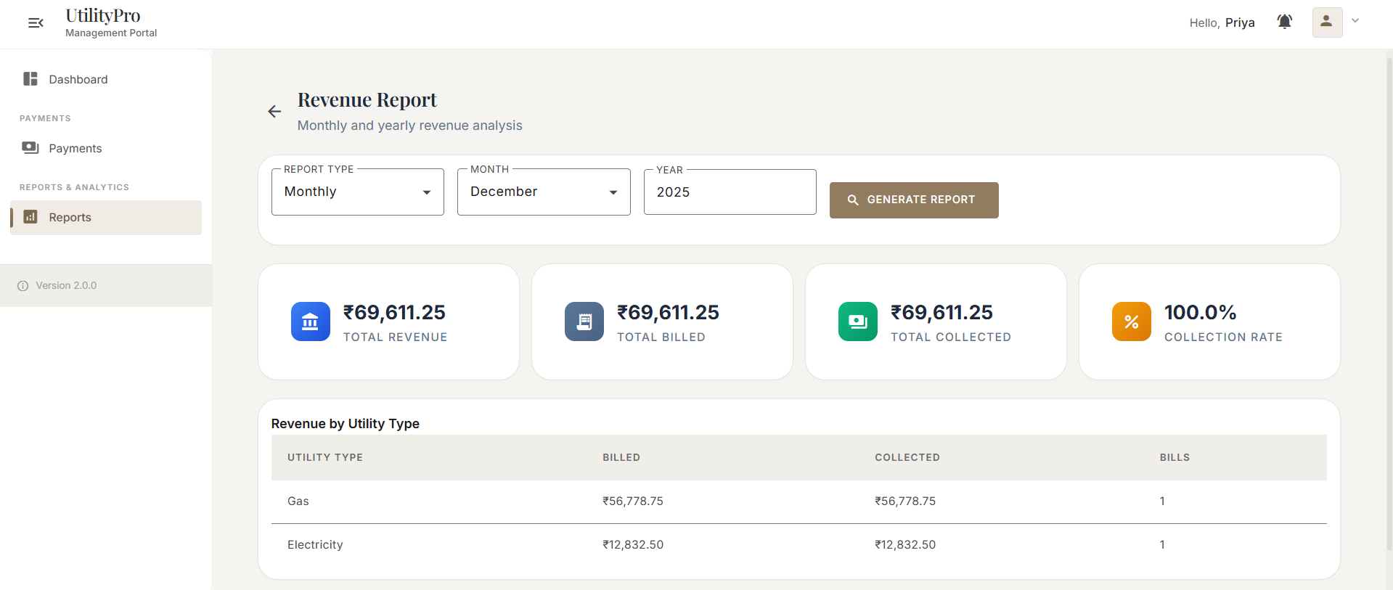
UI Screenshots

Slide 13
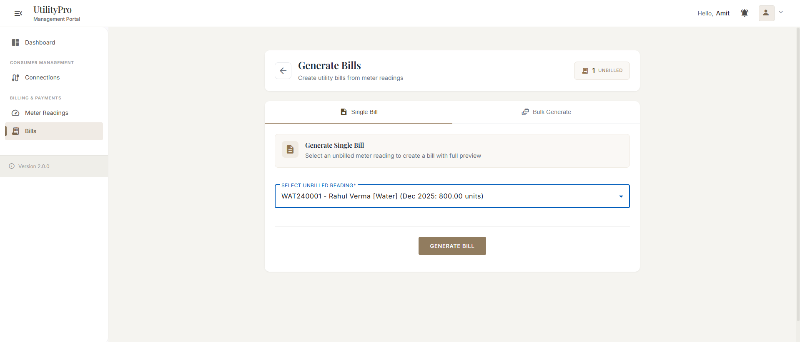
UI Screenshots

Slide 14
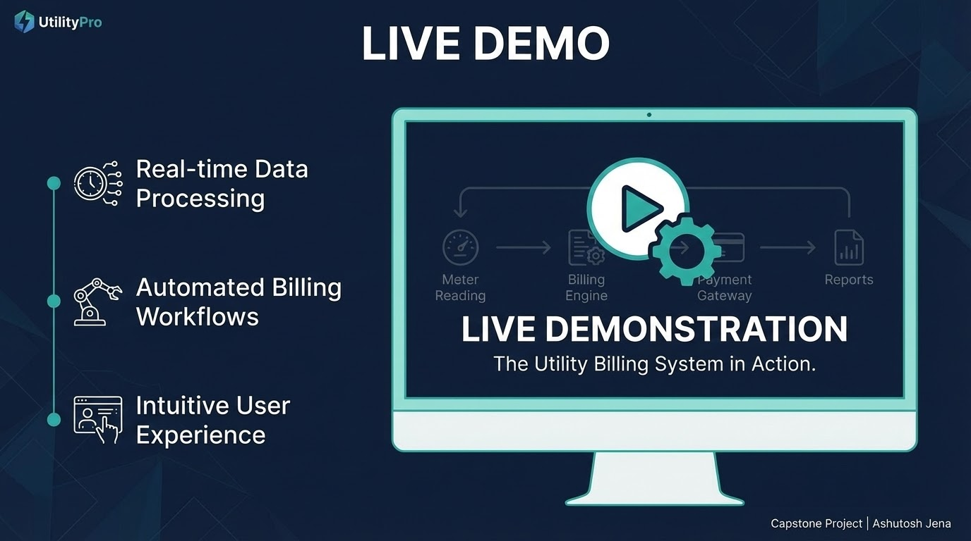

Slide 15


